Slide 1
Service composition in Pervasive Computing Environments
J. Siebert, J. Cao, Y. Lai, P. Guo, and W. Zhu, “LASEC: A localized approach to service composition in pervasive computing environments,” IEEE Transactions on Parallel and Distributed Systems, vol. PP, no. 99, 2014

Slide 2
Service composition
Service: A functionality of a computational entity whose execution satisfies the requestor’s requirement.
Service Composition: A process of identifying and combining component functionalities to compose a higher level functionality and provide means to perform the requested functionality.

Slide 3
Pervasive computing environments

Slide 4
Challenges in large scale dynamic environments
Bottom-up devices collaboration support
Handling changes in environments
Heterogeneity support

Slide 5
Service composition framework

Slide 6
Service composition approaches

Slide 7
Localized approach

Slide 8
Localized approach example
Service request
Valid solutions

Slide 9
Basic idea of LASEC algorithm

Slide 10
Overview of the Solution (1)
Requirements for new solution
There should be no special entity to manage service composition process
Service providers can communicate only with their local neighbours, not all other service providers
No service provider knows the full global information or gathers it
Initially, service providers are atomic, in sense that they provide some functionality and are not coupled with any other service provider to provide a composed service

Slide 11
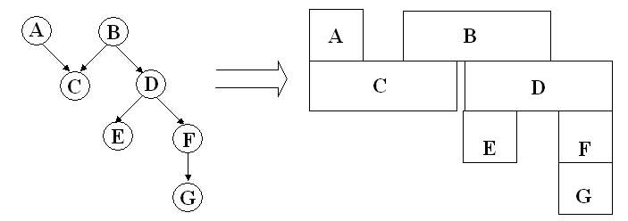
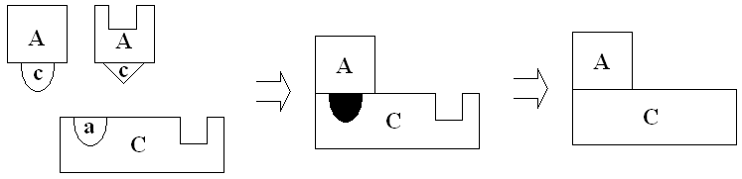
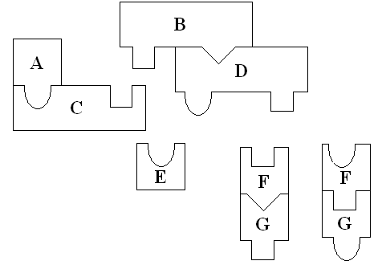
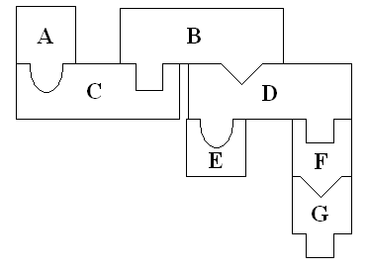
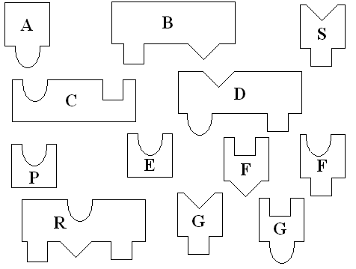
Overview of the Solution (2)
Inspired by the strategies adopted in solving jigsaw puzzles.
Forming service sections: Service provider identifies what service type it needs to interlock with through his output and then searches for appropriate service provider with matching input type.
Growing service: At later stages these sections are joined together with other sections to gradually construct the completed solution.

Slide 12
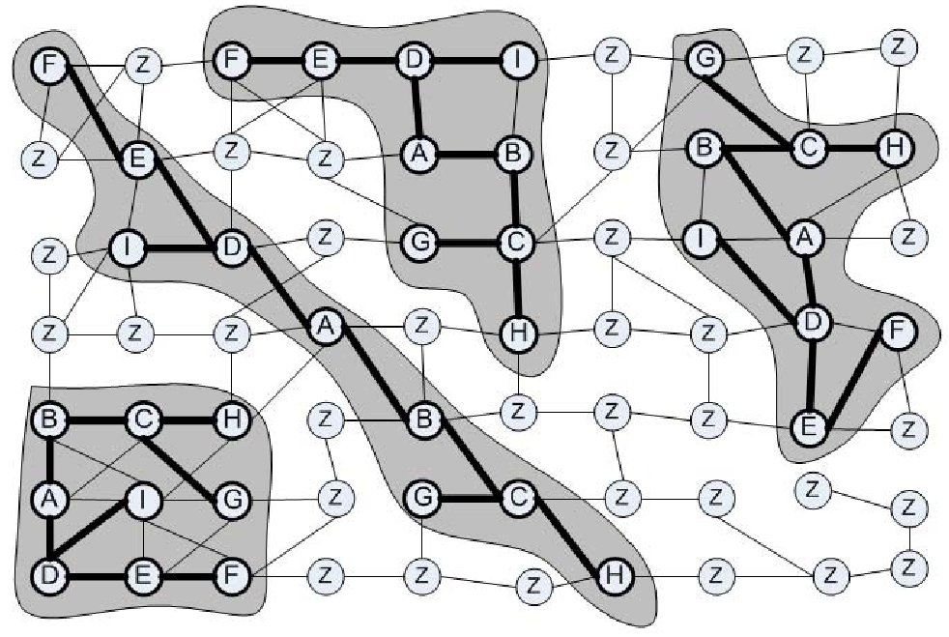
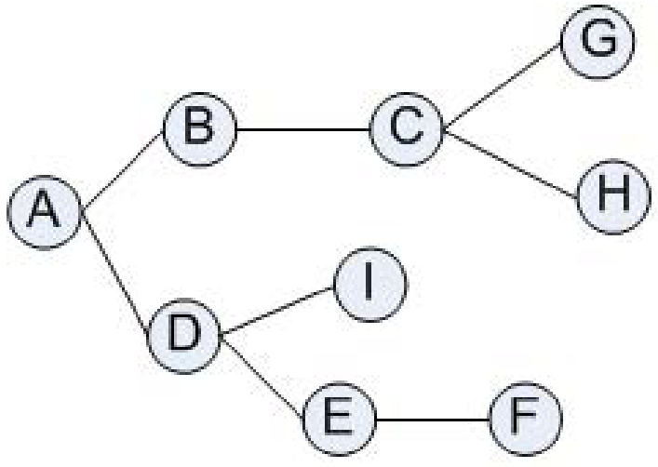
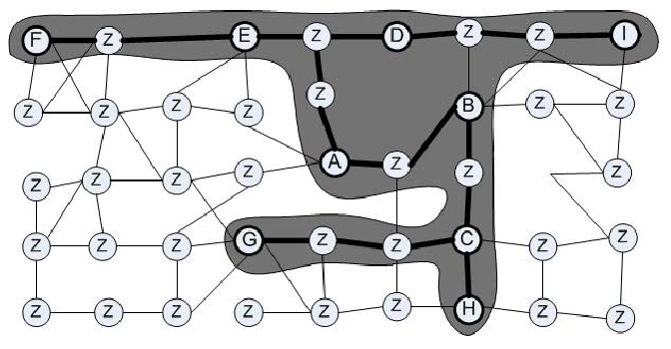
Overview of the Solution (3)

Slide 13
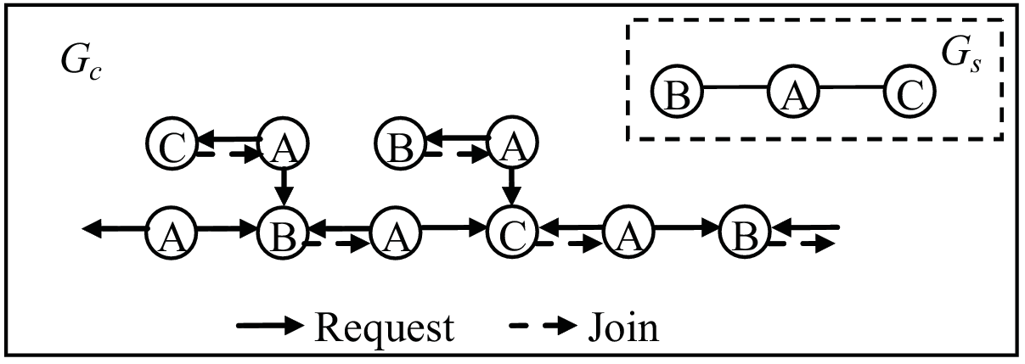
Challenging Issues
Awareness
How does a node know the current members of the section that it has participated in? How does a node know the section that it has participated in has already failed?
Judgment
How does a node know which section is more possible to succeed in the composition when the node is required to join? How to reduce or stop the useless composition which cannot be completed?
Assembly
Since there is no coordinator in the network, how to guarantee the composition to converge into one integrated overlay graph.
How to constraint the blind and random composition among the UIOs that could not form the requested service so as to guarantee all the services specified in the request will be provided

Slide 14
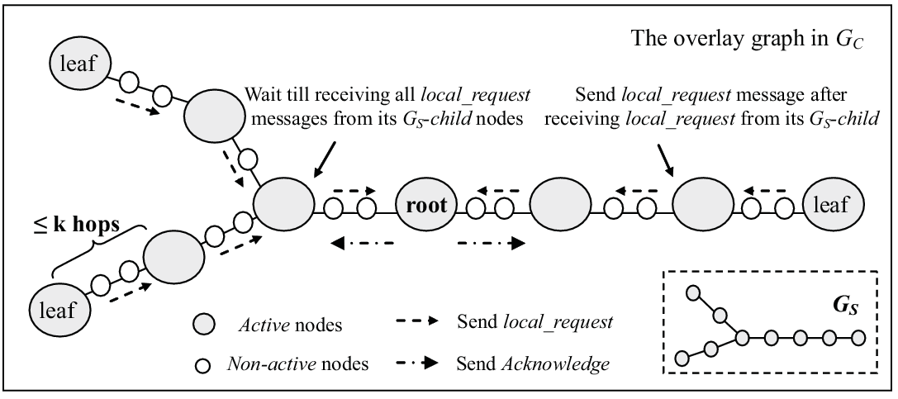
Basic Idea of LASEC
A-Ack mechanism
UIO decide on collaborating with another UIO only after obtaining some additional information from the collaboration candidate.
Specifically this information refers to ability of given UIO to compose another part of the service.

Slide 15
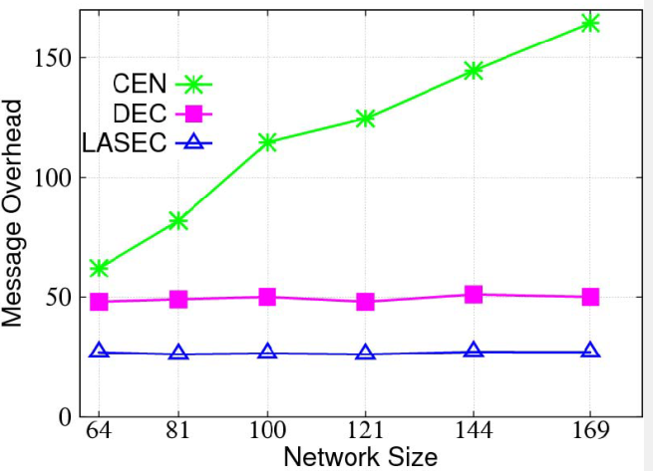
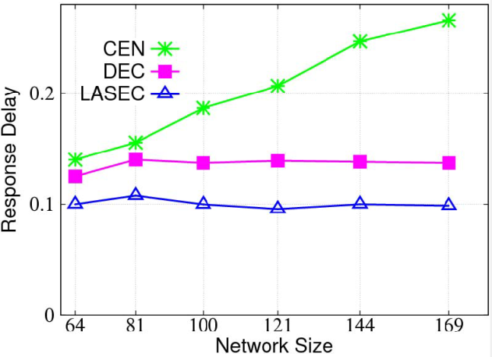
Simulation Results (1)
Scalability with regards to network size
Message overhead
Our LASEC service composition mechanisms require less messages than CEN for finding first result.
LASEC scales very well with the growing size of the network while CEN imposes larger cost when the network grows.
Response delay
LASEC algorithm performs better than DEC and CEN.
Similar as with message cost, LASEC and DEC scale better than CEN.

Slide 16
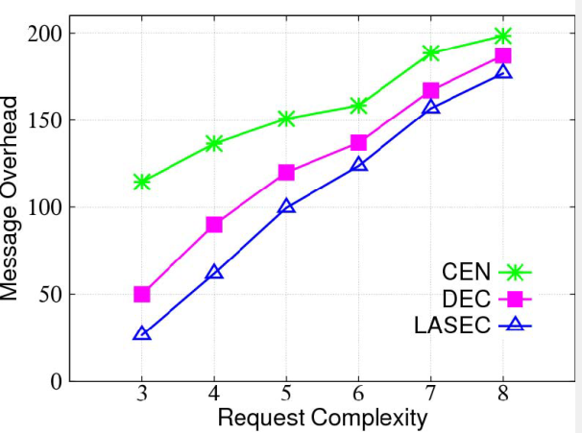
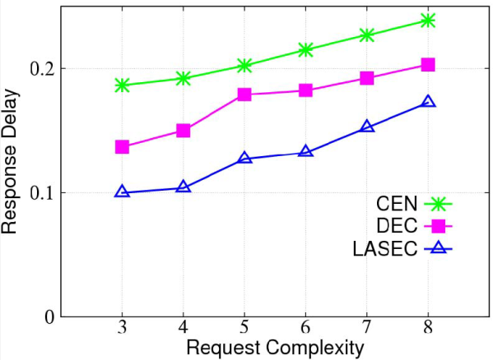
Simulation Results (2)
Scalability with regards to request complexity
Message overhead
Number of messages increases with the complexity of the request.
Along with the growth of request complexity, LASEC and DEC generate more messages, while CEN is more scalable.
Response delay
Our LASEC service composition mechanism performs better than DEC and CEN for finding first result.
Moreover, DEC, CEN and LASEC perform similar in terms of scalability.

Slide 17
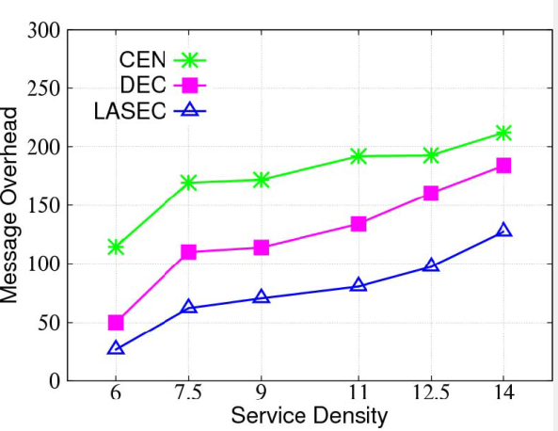
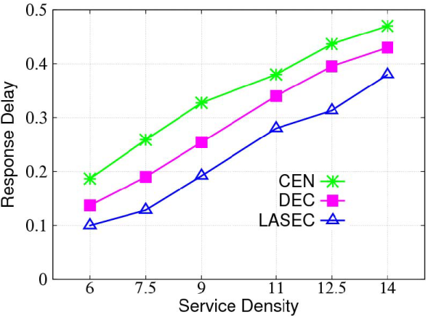
Simulation Results (3)
In these simulations we have explored localized characteristics of our approach and allowed nodes to forward message to 2 hop neighbours only.
We observe that response delay as well as number of messages increase with service density.
Our LASEC service composition mechanism has smaller overhead than DEC and CEN for finding the result

Slide 18
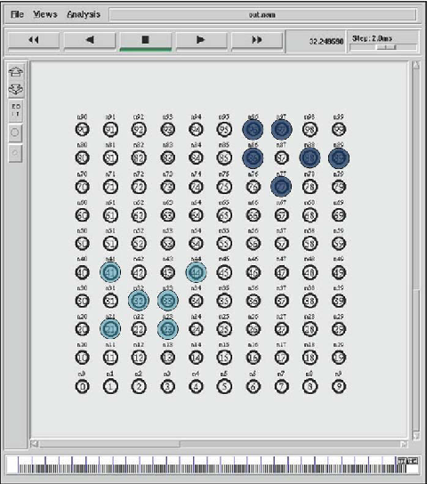
Simulation Results (4)
Composition locality - the distance between the services used in composition
LASEC tends to select compositions with high degree of composition locality

Slide 19
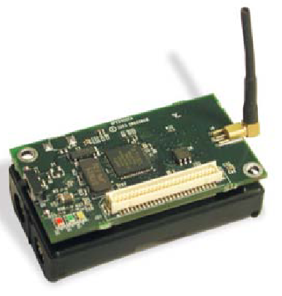
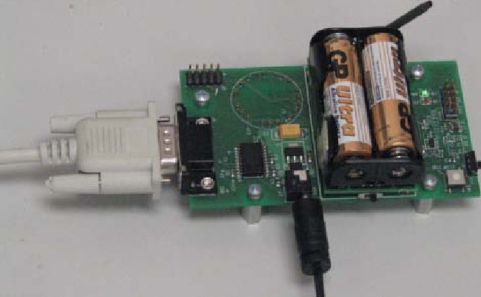
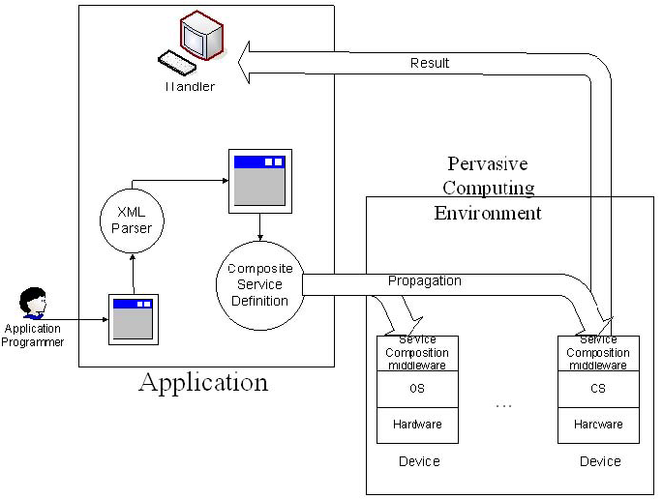
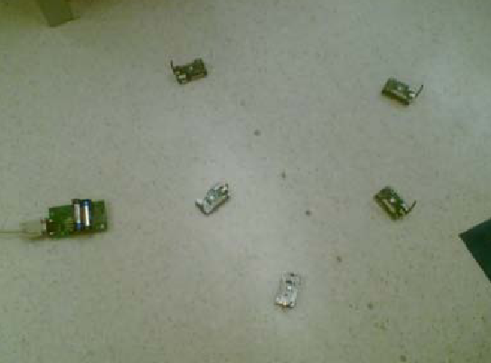
Experiment Results (1)
40 MicaZ nodes with a MIB600 gateway deployed in an indoor environment.

Slide 20
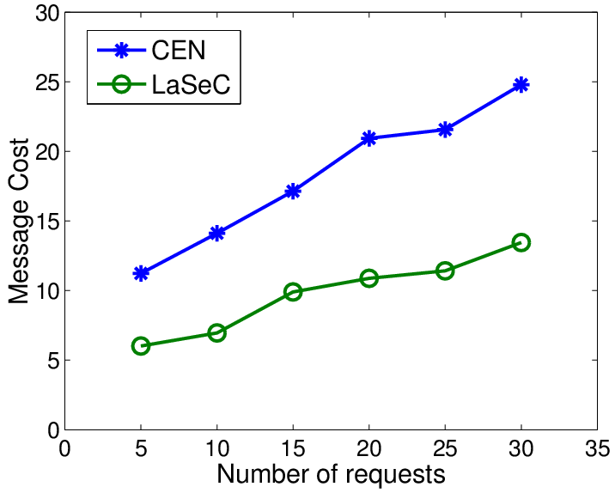
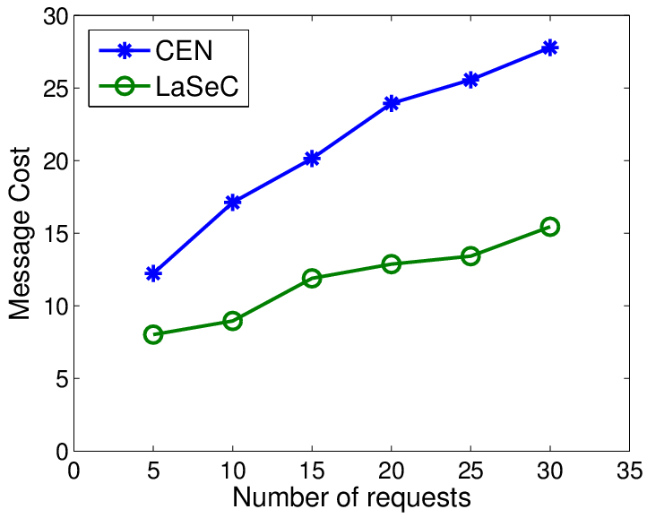
Experiment Results (2)
Message cost
LASEC can reduce the message cost by over 50 percent
LASEC scales better when the number of services increases
10
20

Slide 21
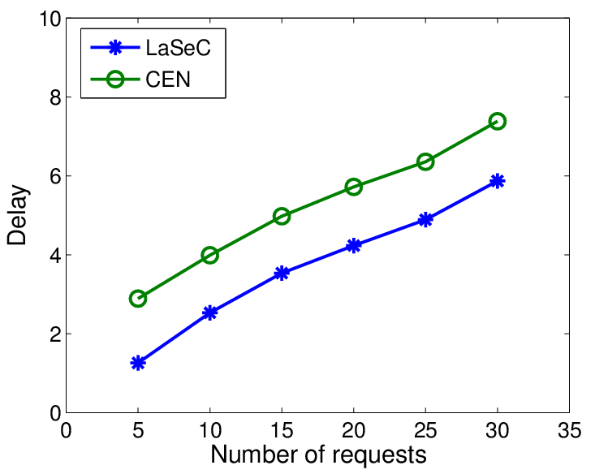
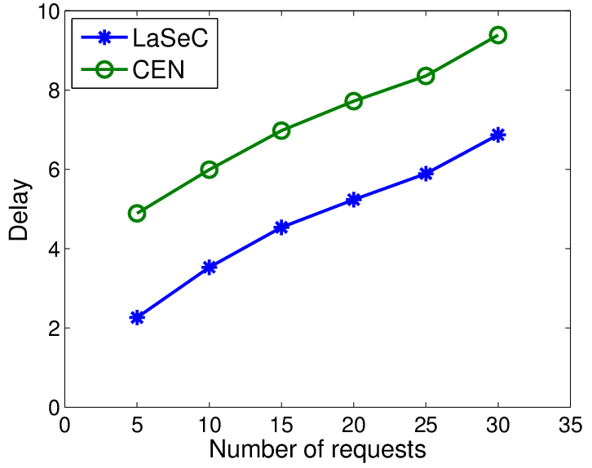
Experiment Results (3)
Message delay
LASEC achieves smaller delay, especially when there are more services in the environment.
10
20

